Slide 1
Saquib

Slide 2
Purpose of the System
Currently, Chegg videos are available on multiple channels aka hosting platforms like youtube, CloudFront and Kaltura.
Each hosting platform has unique data model to represent a video entity.
We need a micro-service to manage video metadata across multiple hosting platforms that has a generic and scalable data model and capabilities to support video metadata management for these hosting platforms.

Slide 3
Key req of the system functional and no functional
Existing video metadata service API is not generic enough to support Kaltura as a video hosting platform.
It thus require re-architecture the existing service to support existing hosting platforms as well as new platforms like Kaltura.
The main reason we need this service is to
To catalog all the videos that we can host on chegg.co and apps.
To store/supply enough metadata against each of the videos so that we can provide the context to the clients

Slide 4
Requirement continue..
Clients need to pass the user id to the video micro-service while requesting for a Video Search Request or a Video details request. If the user requesting the content is not logged in, then the client would either pass null as user id or may not include the user id param in the request at all or clients may not invoke the request to the video micro-service.
Within the video micro-service, identify the type of video content that the user has requested.
If the video content is Subscriber-only (based on current mapping rules the TBS and Q&A videos), then validate user authorization to access the video based on whether the user is a Subscriber or not. The user subscription would be determined by HasAccess API from the Chegg Study - Access Control Engine V2
If the video content is Public, then simply serve the user with video content.

Slide 5
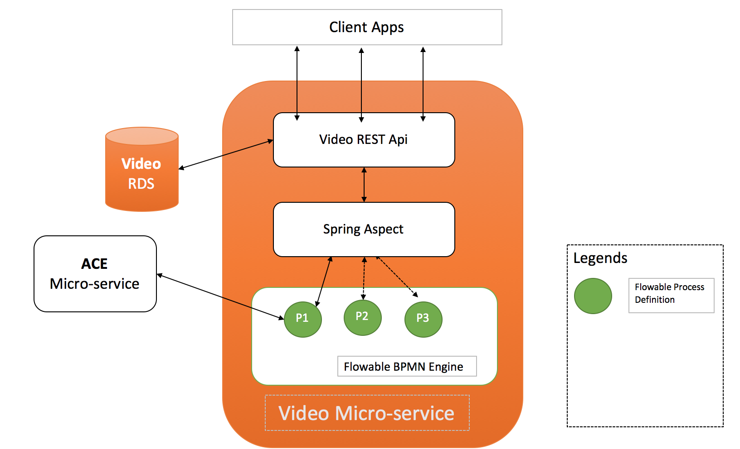
High level Design

Slide 6
Tactics
The video content served by video micro-service can be broadly categorized as Public access content and Subscriber-only content. Videos such as Concepts and Definitions could be considered Public whereas content such as Study Textbook Solution walkthrough videos is only available to subscribers. Having an Access Control mechanism in place helps in providing value additions to the Subscribers over non-subscribers.
The tagging for video content enables the clients(such as Study Web) to implement access control based on the logged in user/logged out user/subscriber use case. The videos are displayed to the user accordingly.
The existing access controls implemented on Client side offer few challenges in terms of security such as man in the middle attack etc because the Client apps(Web and Mobile) have to communicate with the Cheggco study Access control Engine (ACE) in order to authenticate and authorize the user for video content and the video micro-service assumes the responsibility of content security to be governed by the client apps.

Slide 7
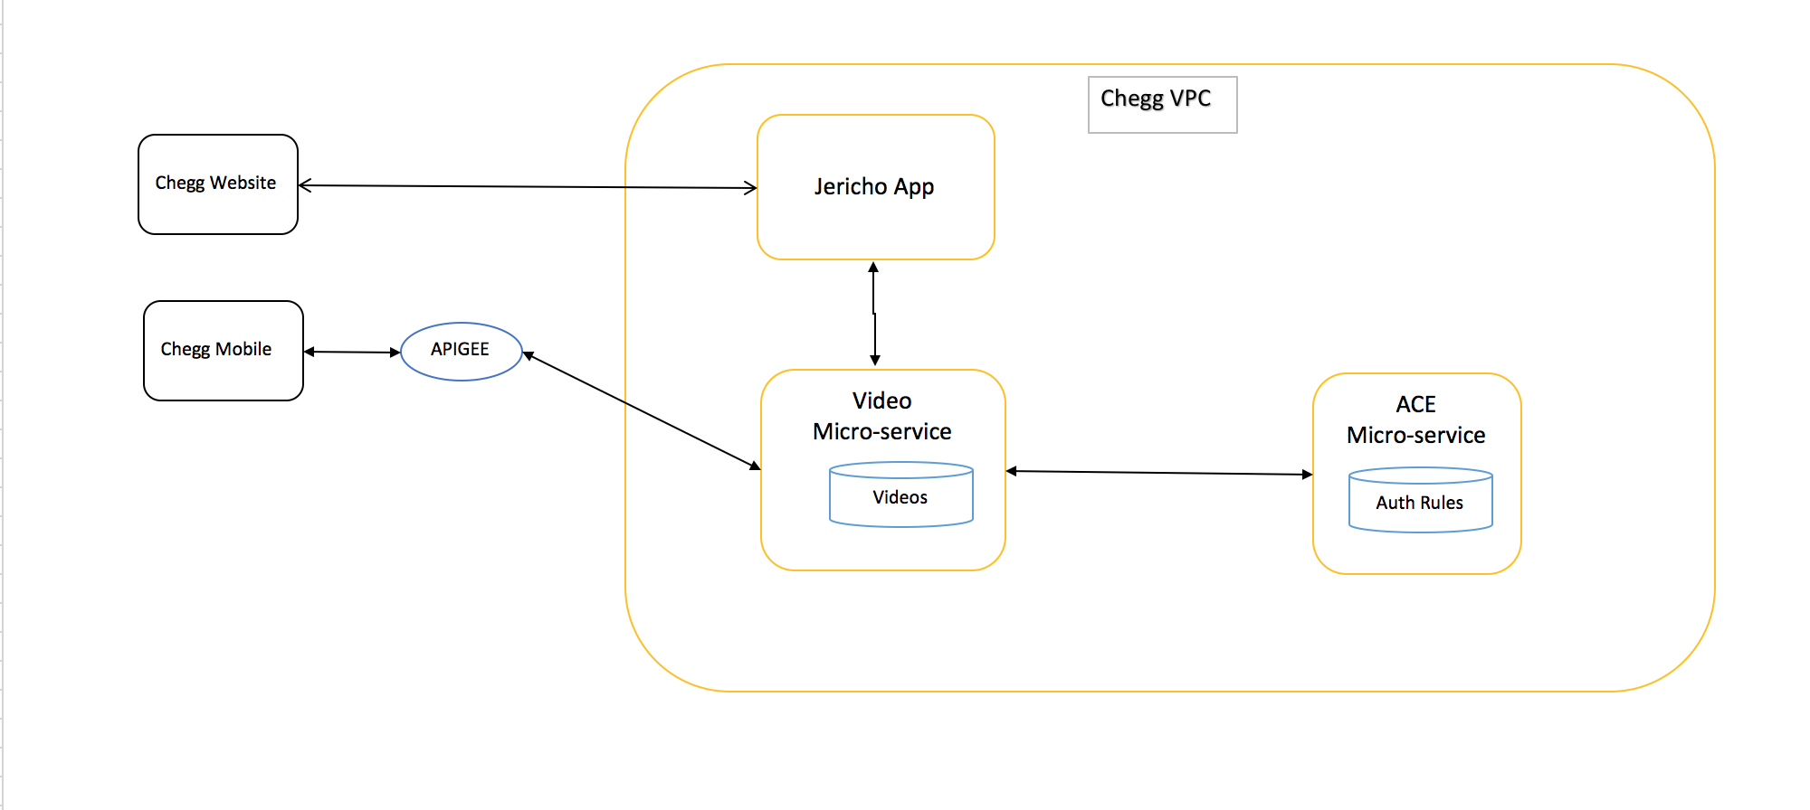
Access Control System Design

Slide 8
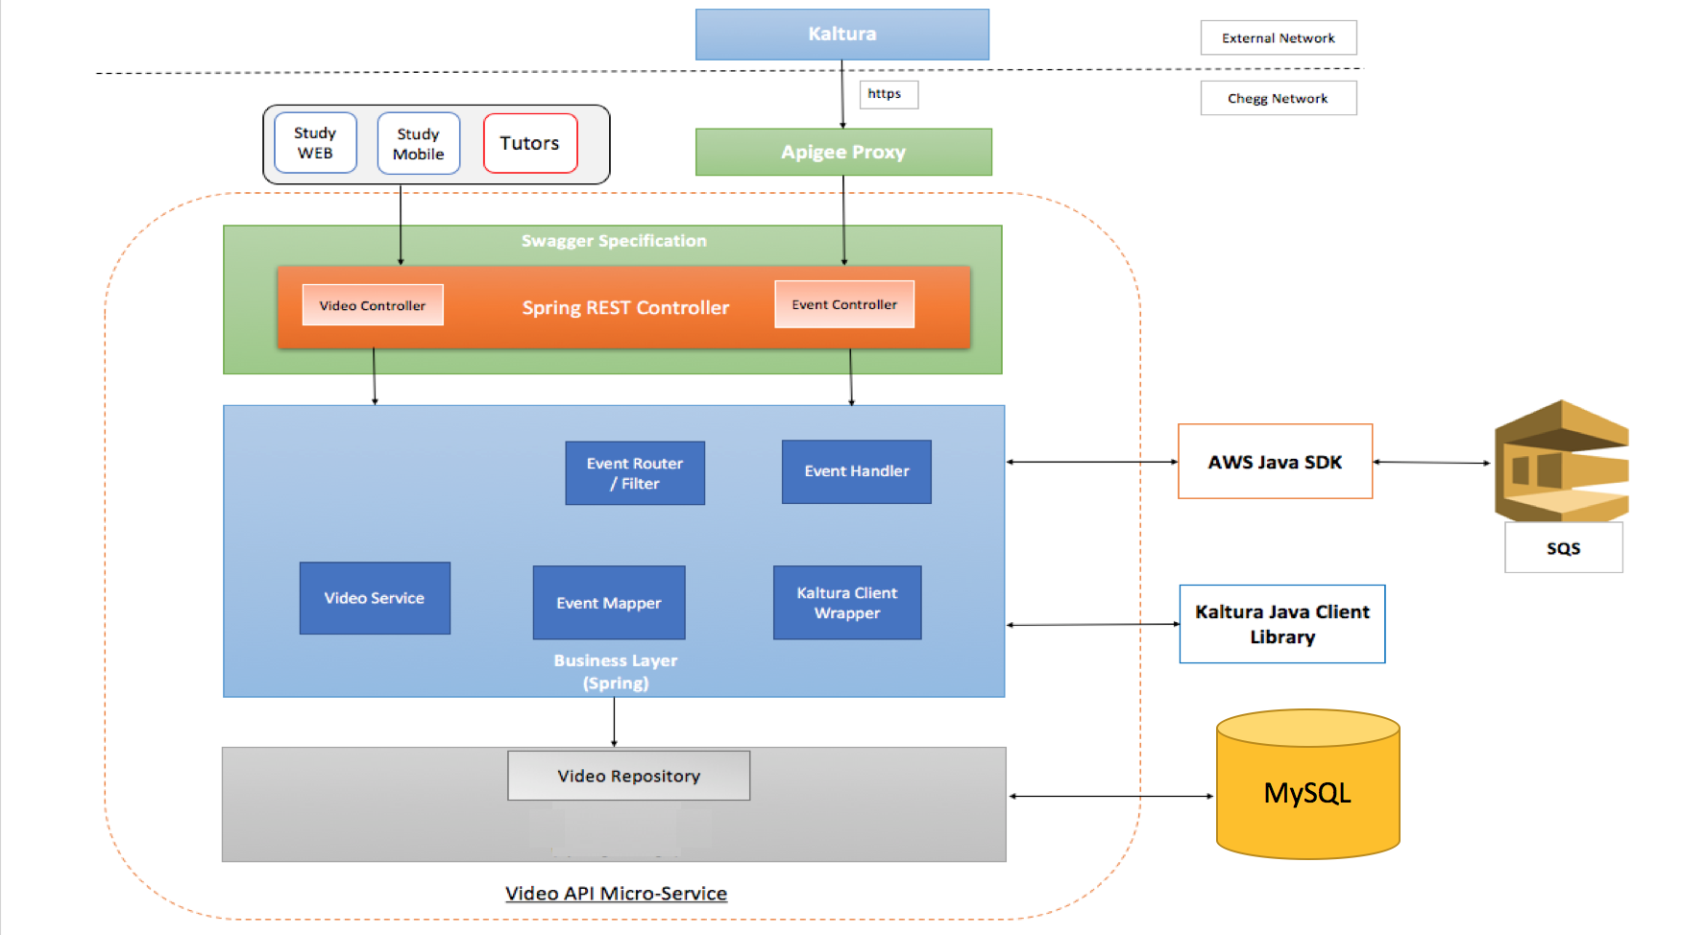
Architecture

Slide 9
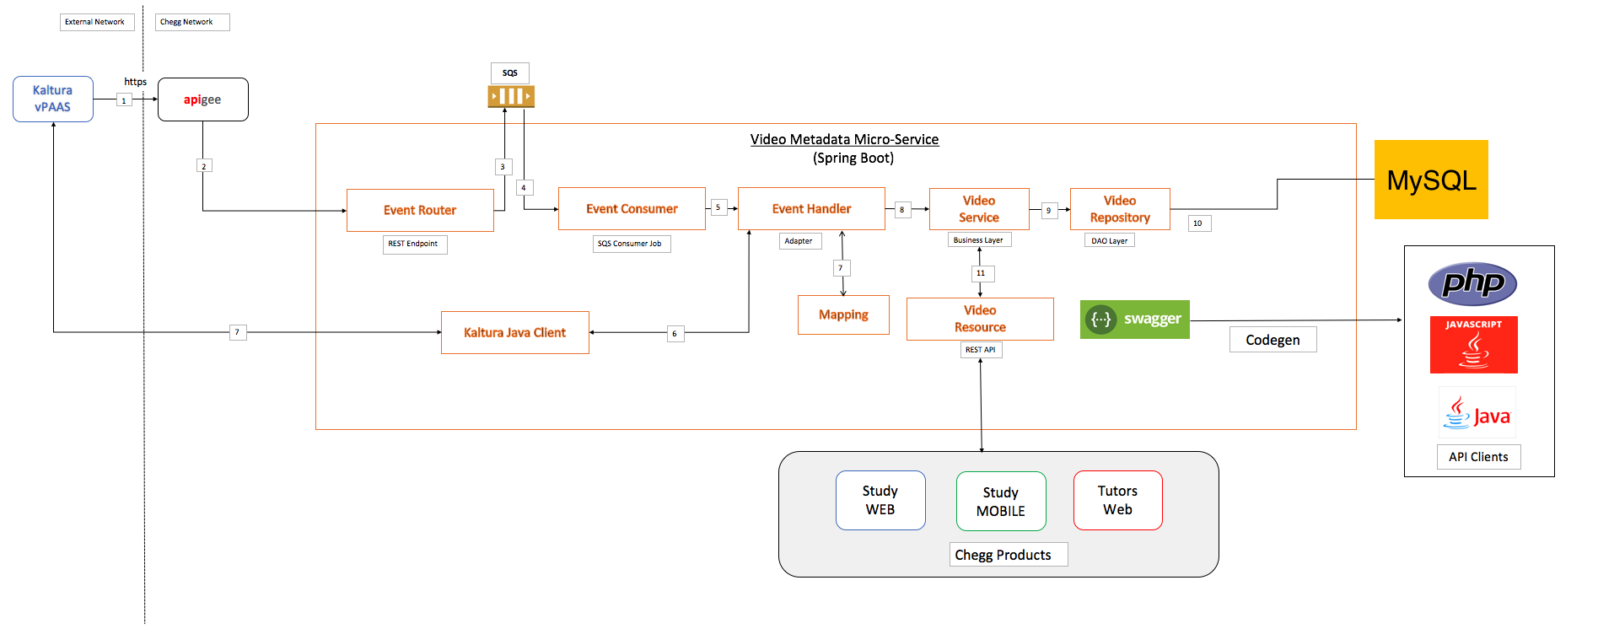
System Flow

Slide 10
How System work
Kaltura would post events for newly published videos to APIGEE proxy layer(https) with authentication key in header and event object in payload.
APIGEE will forward events to Event Router which is a REST endpoint that accepts event object in JSON format.
Event router will publish the events received as is to an Amazon SQS Queue. Before publishing, event router will apply filtering logic to filter out events based on business use case.
Event consumer will poll the Amazon SQS Queue for events.
Event consumer will forward events received from Amazon SQS Queue to Event handler which will parse the event based upon the type of event.
Event handler will retrieve custom metadata information from Kaltura using Kaltura's Java Client library.

Slide 11
Cont…
Event handler will transform the custom metadata information of video into Video-Metadata Micro-service object model based upon mapping rules.
Event handler will then forward the video metadata object to business layer for persisting metadata object.
Business/Service layer will apply any business validations and pass the metadata object to repository layer.
Video repository will persist the metadata object into MySQL data store.
Video resource would provide access to video-metadata stored in MySQL data store over REST API. The REST API could be used by various Chegg products.

Slide 12
Utility tree of Architecture significant requirement

